Slide 1
Vibe Coding
From Chaos to Control: TDD, BDD & SDD with AI Don Demcsak
Ken Richard
Lancaster AI Symposium

Slide 2
What is Vibe Coding?
DEFINITION
→ Prompting AI without structure or constraints
→ Trusting AI output without verification
→ Building fast — validating never
Speed
Ships instantly
Confidence
Sounds authoritative
No Guardrails
Zero verification
VIBING = No plan • No tests • No review • Ship and pray
KEN: "It looked right, so we shipped it."
— The vibe coder's motto

Slide 3
ACT I
Vibe Coding a Business Outcome

Slide 4
Demo: Vibe-Coded OSHA Plan
Prompt: "Create an OSHA compliance document for a small manufacturing shop with 12 employees."
The AI delivers:
✓ Beautiful formatting
✓ Confident tone
✓ Zero hesitation
Fast. Convincing. Unverified.
Google Gemini Demo

Slide 5
You’re Driving. AI is Assisting.
➔ Expand the machine guarding section
➔ Add required training intervals
➔ Iterate and refine — one prompt at a time
HUMAN STEERS
Prompts & direction
AI ASSISTS
Generates & iterates
RESULT
Verified output
KEN: "You're driving, it's assisting. Hold onto that idea — we'll come back to it."

Slide 6
Demo: AI Reviews Its Own Work
Prompt: "As an OSHA Auditor review the generated document."
The AI critiques its own work:
✓ Found critical compliance gaps
✓ Confidently created a plan
✓ Confidently shredded the plan
WHAT IT WROTE:
✓ OSHA compliance plan
✓ Formatted beautifully
✓ Confident, authoritative tone
✓ Covered machine guarding
(After you prompted it to)
WHAT THE AUDITOR FOUND:
✗ Missing hazard assessments
✗ Missing PPE requirements
✗ Missing recordkeeping
✗ Missing training documentation
(In its own plan)
KEN: "AI is not magic. AI is a mirror. If you give it vibes, it gives you chaos."
DON: "And if you don't check its work, it will absolutely get you fined."

Slide 7
ACT II
Vibe Coding a Software Project

Slide 8
Demo: Vibe-Coded Safety Incident App
Prompt: “Build a simple web app to track safety incidents.”
The AI assumes:
✗ Guessed the data model
✗ Skipped validation
✗ Ignored security
✗ Invented business rules
✗ Added a “severity emoji” (bold choice)
DON: "Freshman-at-3AM energy."

Slide 9
AI Reviews Its Own Code
Senior Engineer Review Finds:
✗ No input validation
✗ No sanitization
✗ No error handling
✗ No authentication
✗ No logging
✗ No testing
DON: "It wrote code like I used to… before I learned better."

Slide 10
ACT III
Vibe Coding a Test Plan

Slide 11
Demo: Vibe-Coded Test Plan
Prompt: “Write a test plan for the safety incident tracking app.”
Looks thorough. Reads convincingly. Tests nothing that matters.
What the AI nailed:
✓ Professional-sounding section headers
✓ Confident test case names
✓ Plausible-looking structure
What it completely missed:
✗ Actual test conditions or inputs
✗ Expected vs. actual outcomes
✗ Edge cases or failure modes
DON: "This is the 'did you try turning it off and on again' of test plans."

Slide 12
ACT IV
The Fix: TDD, BDD & SDD

Slide 13
Three Ways to Keep Chaos Under Control
TDD — Test Driven Development
Write a failing test → Make it pass → Refactor → Repeat
BDD — Behavior Driven Development
Given / When / Then — Business and engineering aligned
SDD — Spec Driven Development
The specification IS the source of truth

Slide 14
TDD: Test Driven Development
Red → Green → Refactor
RED
Write a failing test
GREEN
Make the test pass
REFACTOR
Clean up the code
↺ REPEAT
DON: "You don't vibe. You constrain."
KEN: "This is TDD. Write the test first. Always."

Slide 15
BDD: Behavior Driven Development
Where business and engineering meet in the middle
Prompt: “Write a Given/When/Then scenario for logging a safety incident.”
GIVEN
A worker is logged into the system
WHEN
They submit a new safety incident report
THEN
The incident is saved and a notification is sent
KEN: "Readable by humans. Testable by machines."

Slide 16
SDD: Spec Driven Development
The specification IS the source of truth
Prompt: “Write a spec using GIVEN / WHEN / THEN / SO THAT / AS MEASURED BY.”
GIVEN
A logged-in worker
WHEN
They submit a safety incident
THEN
It is saved with a timestamp
SO THAT
Safety managers can track trends
MEASURED BY
100% of incidents have all required fields
KEN: "This is the contract. This is the blueprint. This is how you prevent vibe-driven disasters."

Slide 17
That Was Paired Programming
Remember when Ken and Don were refining the OSHA plan together?
That was paired programming — they just didn’t name it.
DON
STEERS
KEN
QUESTIONS
AI
ASSISTS
KEN: "No vibes. Just collaboration. And that's the future."

Slide 18
AI doesn't replace people.
AI doesn't replace developers.
AI doesn't replace testers.
AI doesn't replace business owners.
AI replaces guessing.
TDD, BDD, and SDD are how you remove the guesswork.
But Wait – There is more!

Slide 19
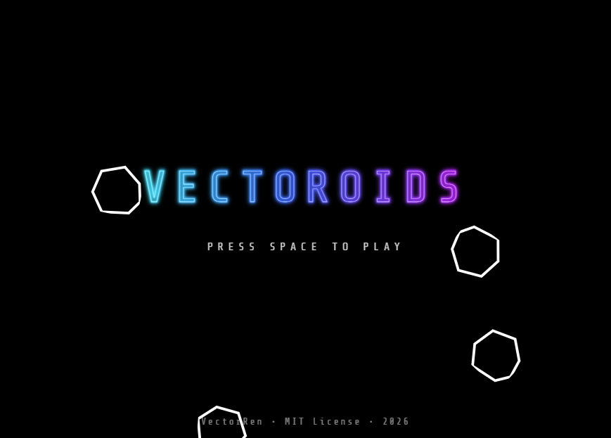
VectorRen & Vectoroids
A Tiny Renaissance Project
▸ Web-based · no dependencies · SVG
▸ Clean specs
▸ BDD-driven
▸ Built with a Coding Assistant
▸ Born from curiosity & mischief
Build Small. Build Sharp. Build Joyful.
Where classic vectors meet AI-enabled human joy
https://vectorren.org/
https://github.com/dondemcsak/VectorRen
— Don & Ken | Lancaster AI Symposium | Questions Welcome

